Slide 1
WP4 Event Registry
Gregor Leban, Aljaž Košmelj, Blaž Fortuna, Marko Grobelnik
Jozef Stefan Institute

Slide 2
Event registry
Event registry is a system for
automatic identification of world events from news articles
Extraction of core event information
All extracted information searchable
Rich visualization options
1st prototype was presented last year
Updates/extensions will be highlighted in bold

Slide 3

Event registry pipeline
Data collection
Article-level processing
Event construction
Event storage & maintenance
Semantic annotation
Article clustering
Manual event administration
Cross-lingual cluster matching
Extraction of date references
Main stream news
Event formation
Detection of article location
Event info. extraction
Cross-lingual article matching
Filling event template
Detection of article duplicates
Frontend
interface
API access
Identifying related events

Slide 4
Event registry pipeline
Data collection
Article-level processing
Event construction
Event storage & maintenance
Semantic annotation
Article clustering
Manual event administration
Cross-lingual cluster matching
Extraction of date references
Main stream news
Event formation
Detection of article location
Event info. extraction
Cross-lingual article matching
Filling event template
Detection of article duplicates
Frontend
interface
API access
Identifying related events

Slide 5
Input data
We built a data collection service News Feed
http://newsfeed.ijs.si/
Monitoring ~90k mainstream news RSS feeds
Data volume: ~100k articles per day
14 Languages used in Event Registry:
eng, ger, spa, chi, slo, cat, por, ita, fra, rus, ara, tur, cro, ser

Slide 6
Event registry pipeline
Data collection
Article-level processing
Event construction
Event storage & maintenance
Semantic annotation
Article clustering
Manual event administration
Cross-lingual cluster matching
Extraction of date references
Main stream news
Event formation
Detection of article location
Event info. extraction
Cross-lingual article matching
Filling event template
Detection of article duplicates
Frontend
interface
API access
Identifying related events

Slide 7
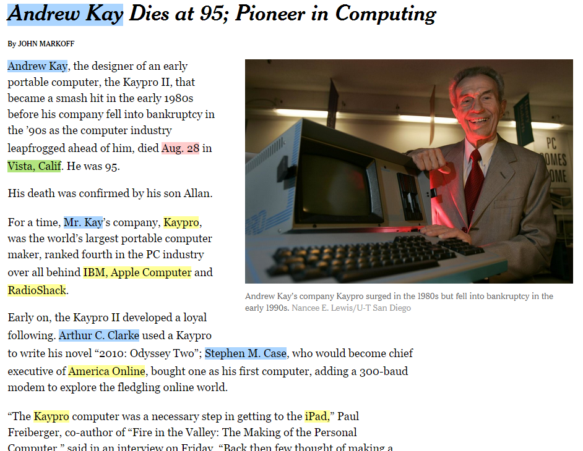
Article semantic annotation
Annotating concepts/entities in text with Wikipedia URLs
Extended the annotation service to annotate the additional languages

Slide 8
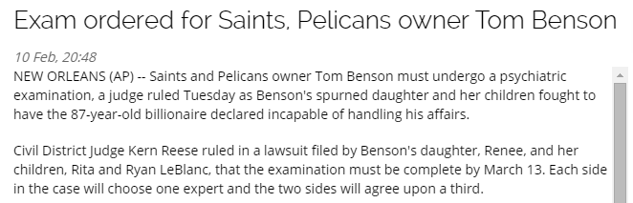
Detection of article location
Articles often contain „datelines“
Datelines provide information about where the story occurred
We implemented parsing of various ways in which the datelines can mention the story location

Slide 9
Finding similar articles in other languages
Using CCA we can identify articles in other languages that contain similar content
Used to determine if articles in different languages are about the same event
Extended the computation for larger set of languages
data, mining, knowledge, artificial, machine,discovery, buzzword, term, ...,
datos, minería, modelos, utilizando, procesamiento inteligencia, ...,
Sparse
vectors
Common semantic space
Documents as vectors
500 dimensions

Slide 10
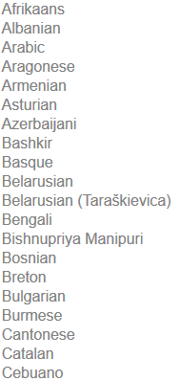
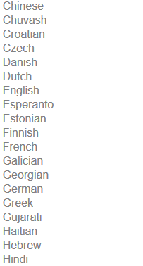
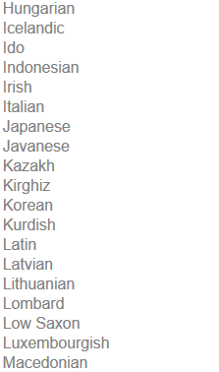
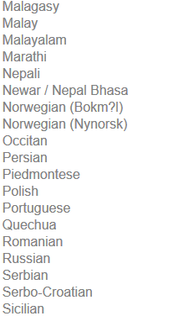
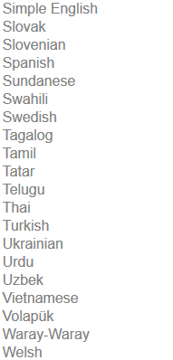

Languages covered by Xling (top 100 Wikipedia languages)

Slide 11
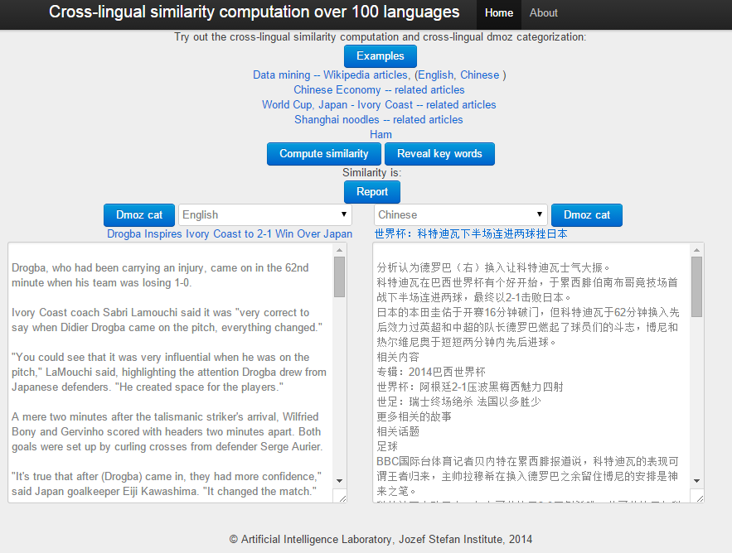
CCA demo
http://XLing.ijs.si

Slide 12
Event registry pipeline
Data collection
Article-level processing
Event construction
Event storage & maintenance
Semantic annotation
Article clustering
Manual event administration
Cross-lingual cluster matching
Extraction of date references
Main stream news
Event formation
Detection of article location
Event info. extraction
Cross-lingual article matching
Filling event template
Detection of article duplicates
Frontend
interface
API access
Identifying related events

Slide 13
Article clustering
Identify groups of articles that describe a single event
Online clustering algorithm
Grouping based on article title + article content + detected named entities
Implementation of a multithreading approach to support clustering of 1M+ articles per day

Slide 14
Cross-lingual cluster linking
Each cluster only contains articles in the same language
Clusters in different languages can describe the same event
How can we find such clusters?

Slide 15
Cross-lingual cluster linking (2)
We find candidates by using info from cross-lingual article linking
English articles
Spanish articles
Most similar articles in Spanish
candidates

Slide 16
Cross-lingual cluster linking (3)
For each candidate pair of clusters we also compute other features:
Similarity of relevant concepts in each cluster
Time difference between articles in each cluster
Similarity of article categories
Agreement in story location
...
Using the computed feature vector we perform classification using an SVM model
Classification accuracy of the model is 85% (tested on 520 hand-labeled examples)

Slide 17
Event formation
Using one or more linked clusters we form an event
Each event is assigned a unique id
An event is not static
As clusters evolve, they can be added or removed from the event

Slide 18
Event information extraction
From each event we want to extract relevant information using the articles
We want to answer questions what, when, where, who
We extract/determine:
Event title and snippet
Event date
Main event entities and keywords
Event categories
Event location

Slide 19
Event location
For each location we identify candidates for event location
based on locations identified in the articles
For each candidate we extract a set of features
Num. of times it occurs in the dateline
Num. of times it occurs in the article body
Ratio of event articles mentioning the location
...
We use a SVM classification model to determine which (if any) location is the correct event location
Achieved prediction accuracy: 98%

Slide 20
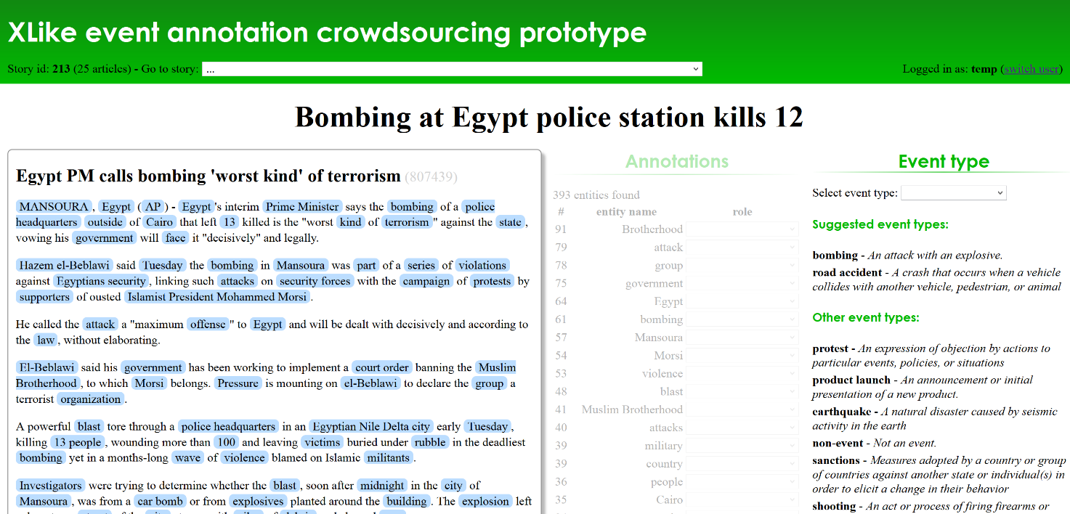
Event template extraction
We want to extract more structured information about events
Crowd-sourcing approach
http://aidemo.ijs.si/eventAnnotation
More info in next presentation

Slide 21
Event registry pipeline
Data collection
Article-level processing
Event construction
Event storage & maintenance
Semantic annotation
Article clustering
Manual event administration
Cross-lingual cluster matching
Extraction of date references
Main stream news
Event formation
Detection of article location
Event info. extraction
Cross-lingual article matching
Filling event template
Detection of article duplicates
Frontend
interface
API access
Identifying related events

Slide 22
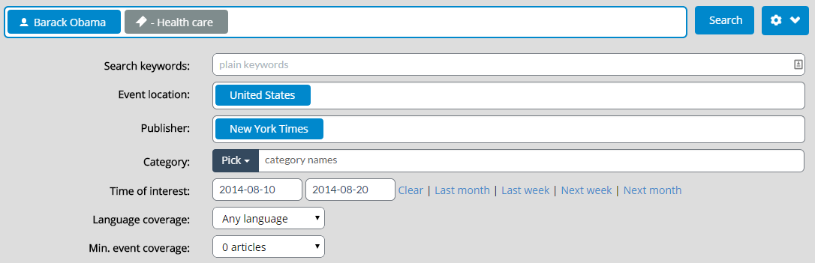
Event registry
Event registry provides extensive search options...

Slide 23
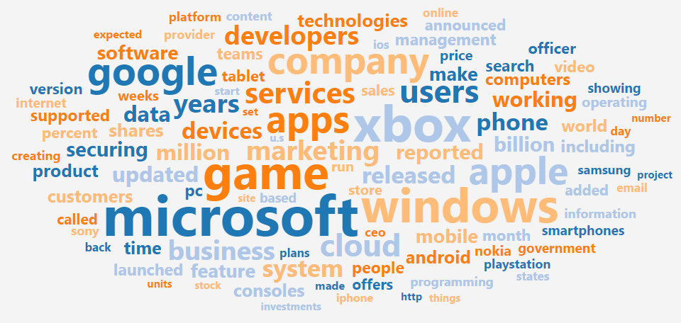
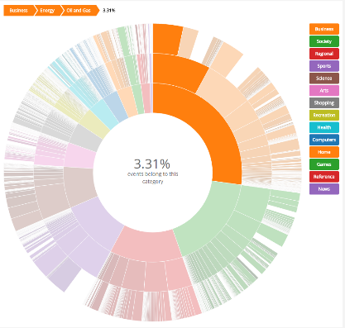
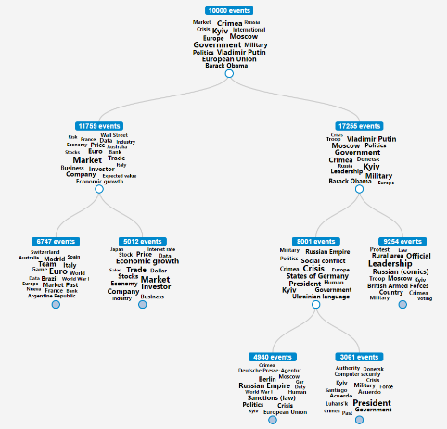
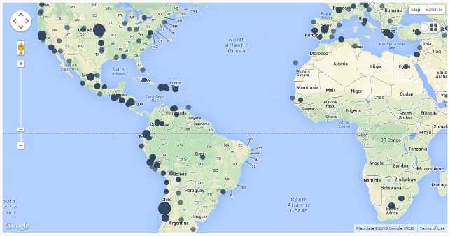
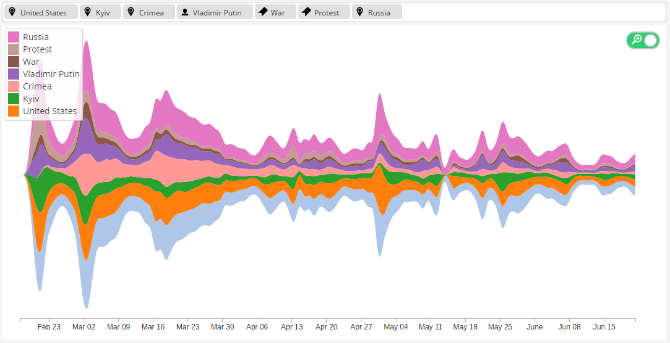
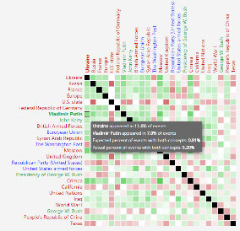
Event registry (2)
... and visualizations of search results

Slide 24
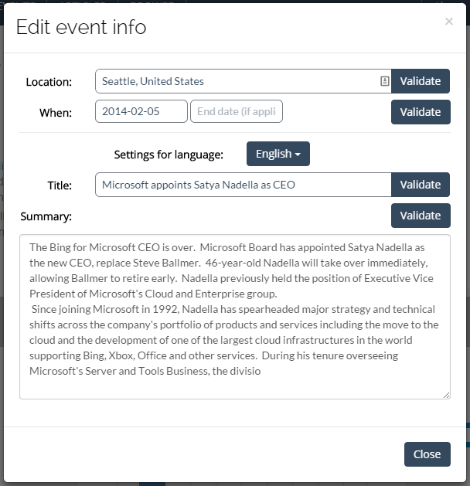
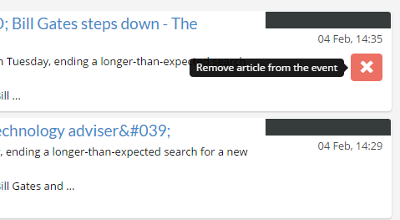
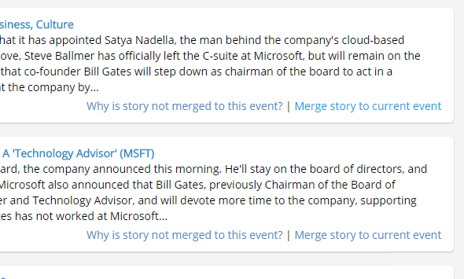
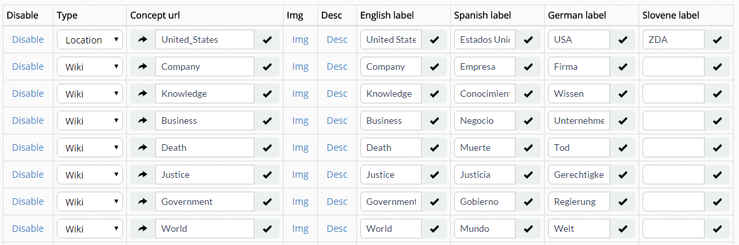
Content administration
Content about events, articles, concepts, ... can be changed by administrators

Slide 25
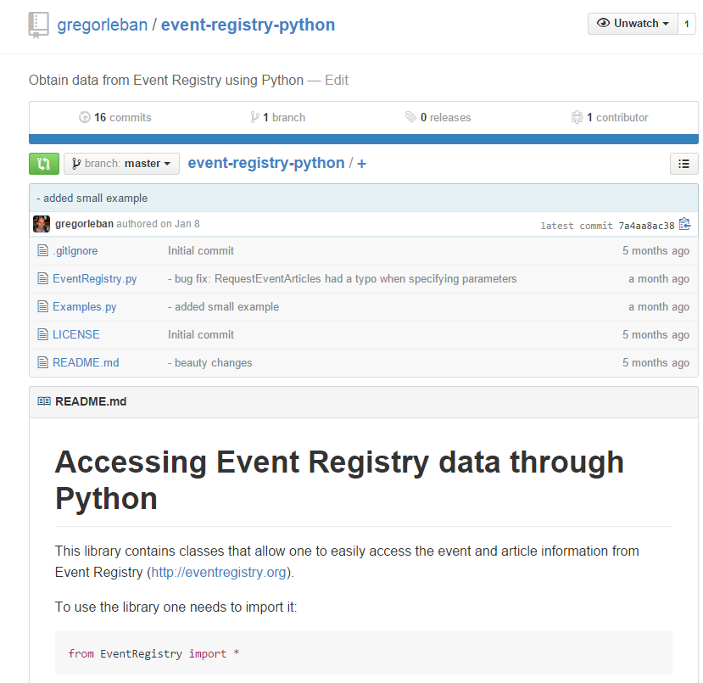
API access
Content in Event Registry can be accessed using the API
To simplify access, a Python library is available at
https://github.com/gregorleban/event-registry-python
Alternatively, data can be accessed also through node.js module: https://www.npmjs.com/ package/qminer

Slide 26
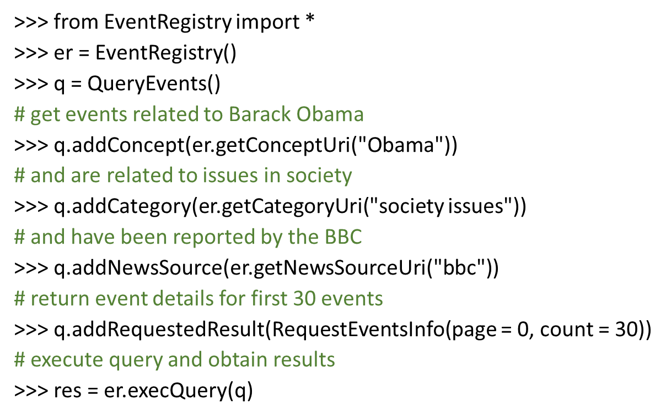
API access example (1)

Slide 27
API access example (2)
‘events’: { ‘resultCount’: 122,
‘results’: [
{'articleCounts': {'eng': 54.0, 'total': 54.0},
'categories': [{...}],
'concepts': [{...}, ...],
'eventDate': '2014-08-29',
'eventDateEnd': '',
'multiLingInfo': { 'eng': {
'title': ..., 'summary': …}},
'uri': '1211229', 'wgt': 9.0}
}, …
]}

Slide 28
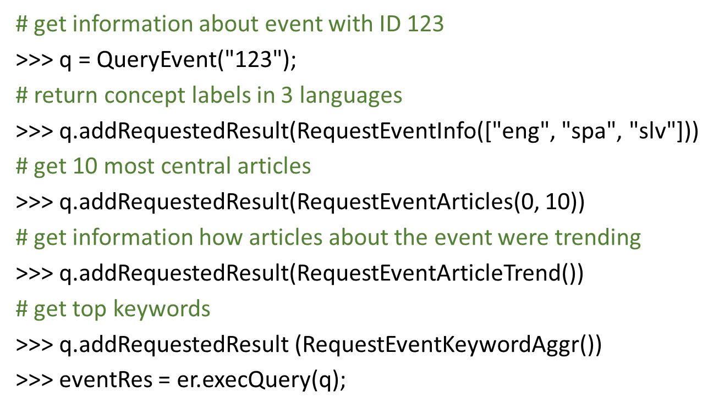
API access example (3)

Slide 29
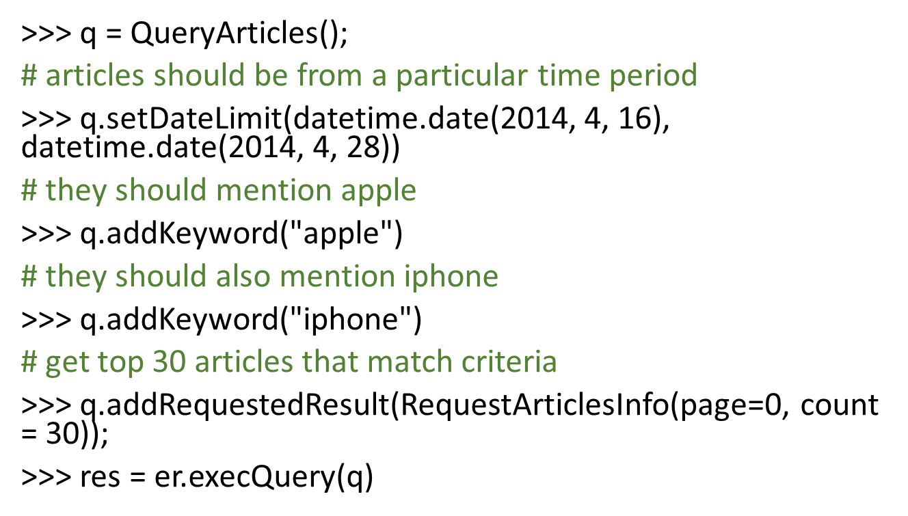
API access example (4)

Slide 30
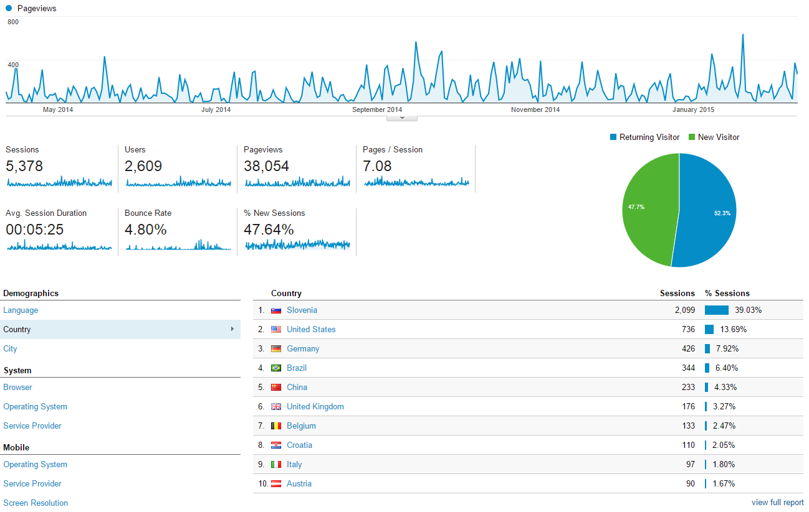
Analytics of ER usage (1)

Slide 31
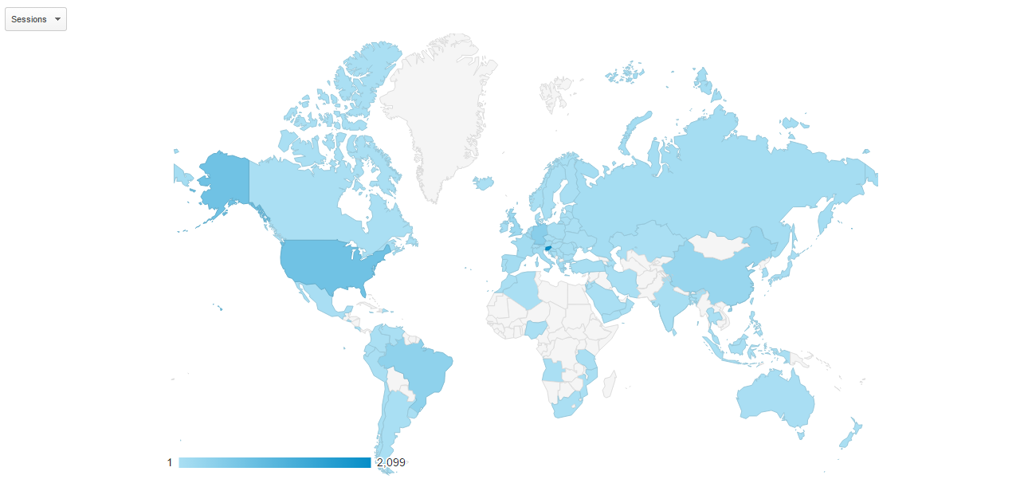
Analytics of ER usage (2)

Slide 32
Future work
Information diffusion
How is information copied between publishers
Integration of news bias analytics
Building of a comprehensive taxonomy of event types
Development of methods for (semi-) automatic population of info-boxes
Integration of additional types of data
Social media content (twitter) and tv news reporting (XLime project)

Slide 33
Thank you!
Questions?

Slide 34
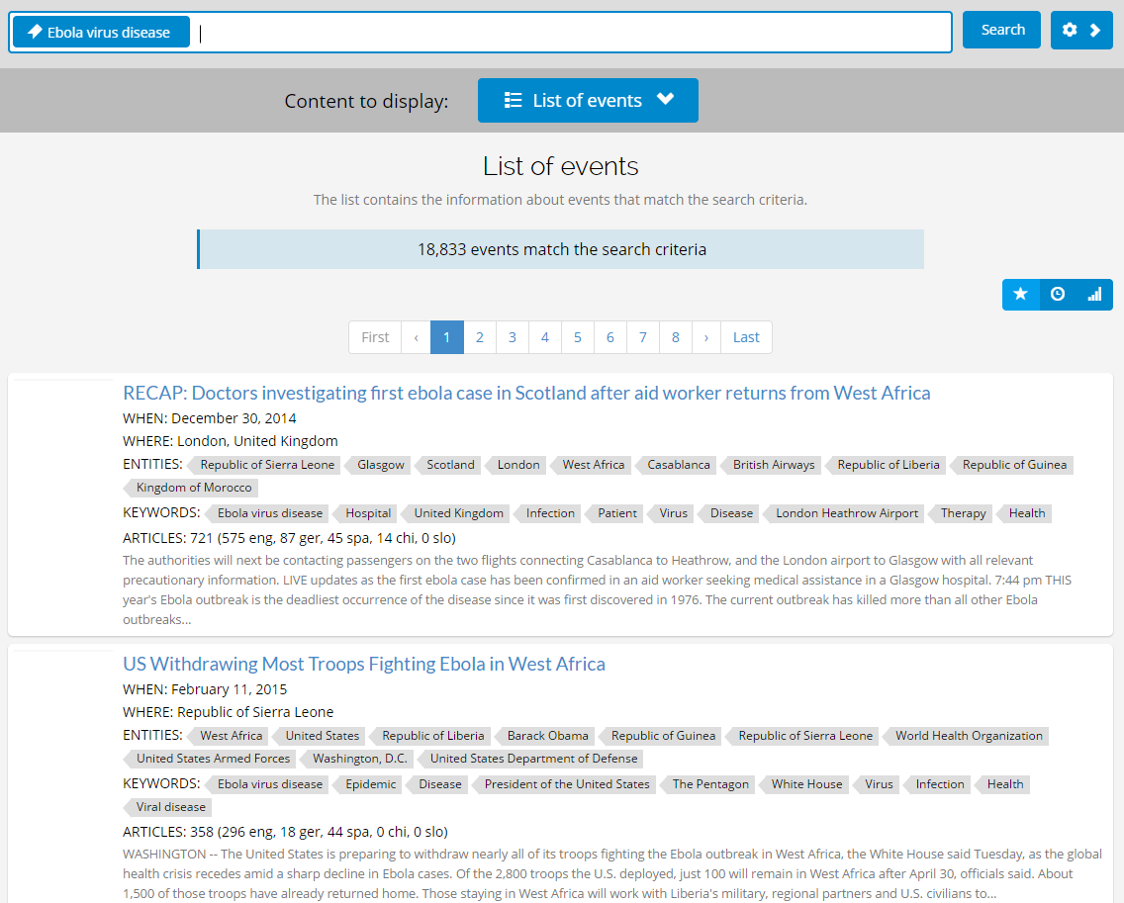

Slide 35
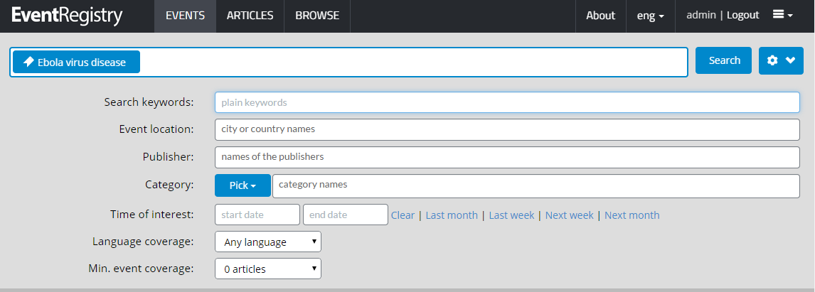

Slide 36
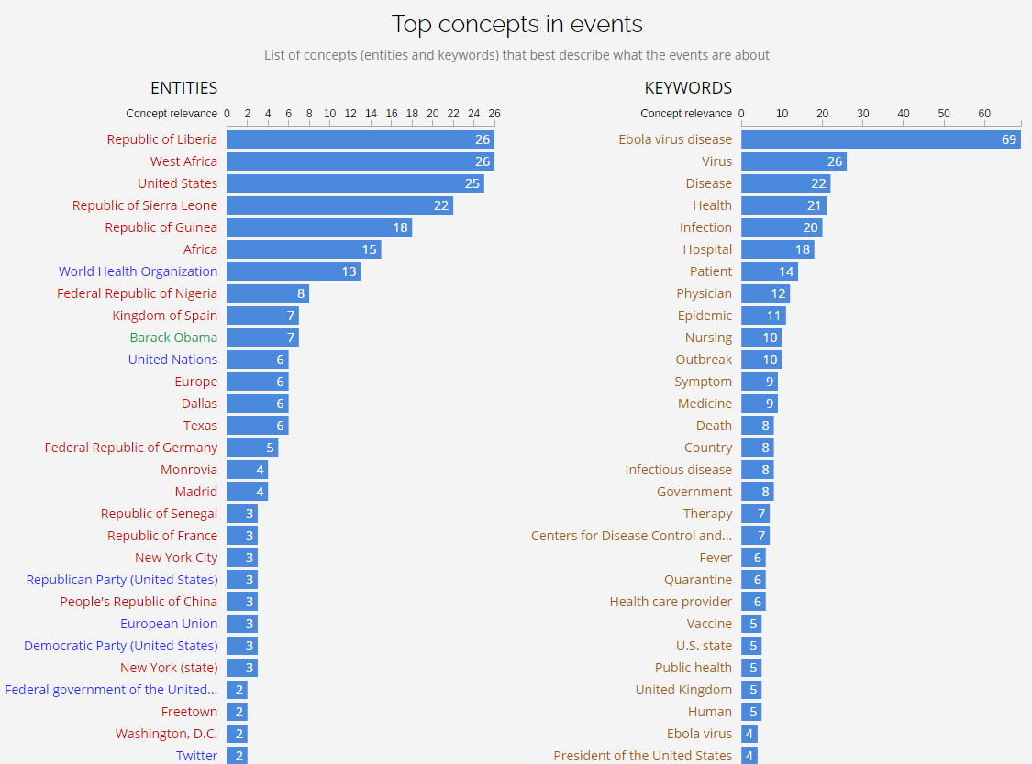

Slide 37
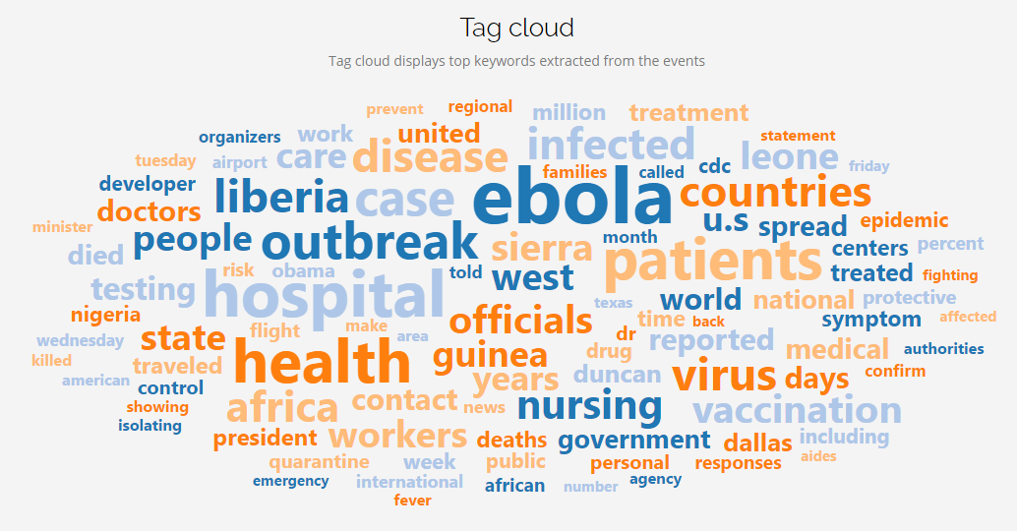

Slide 38
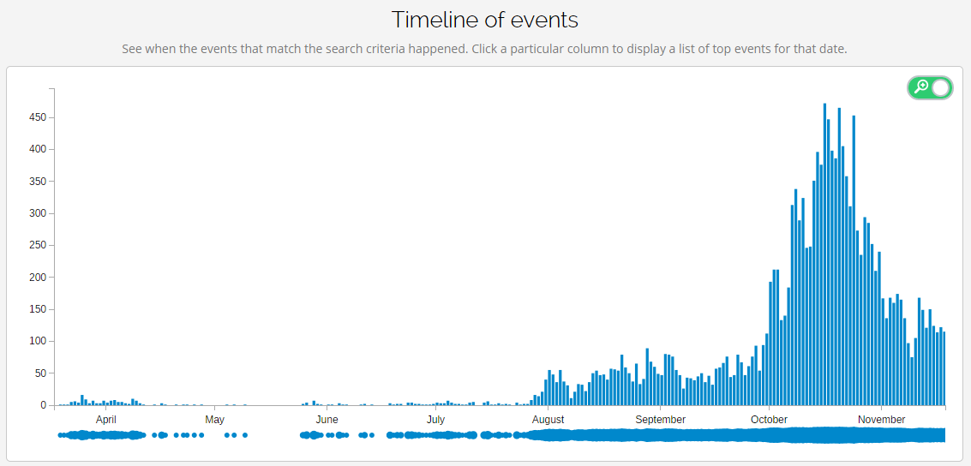

Slide 39
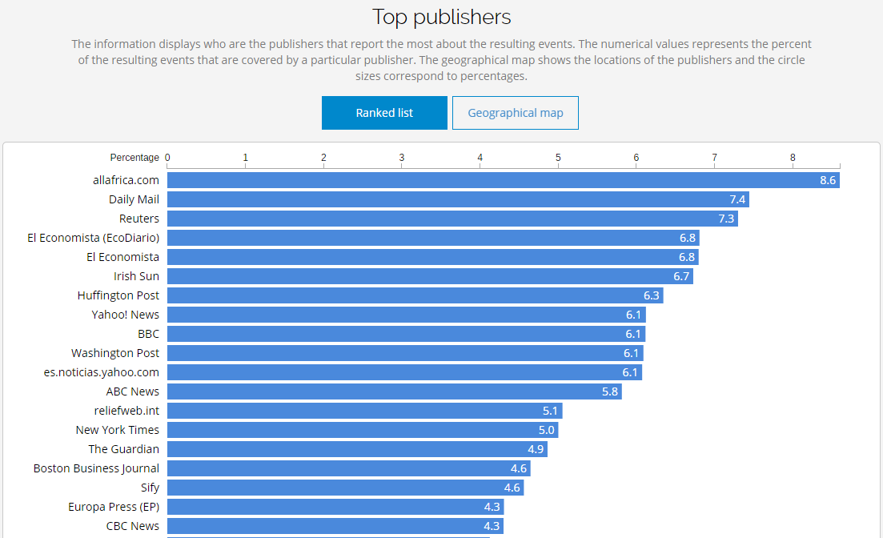

Slide 40
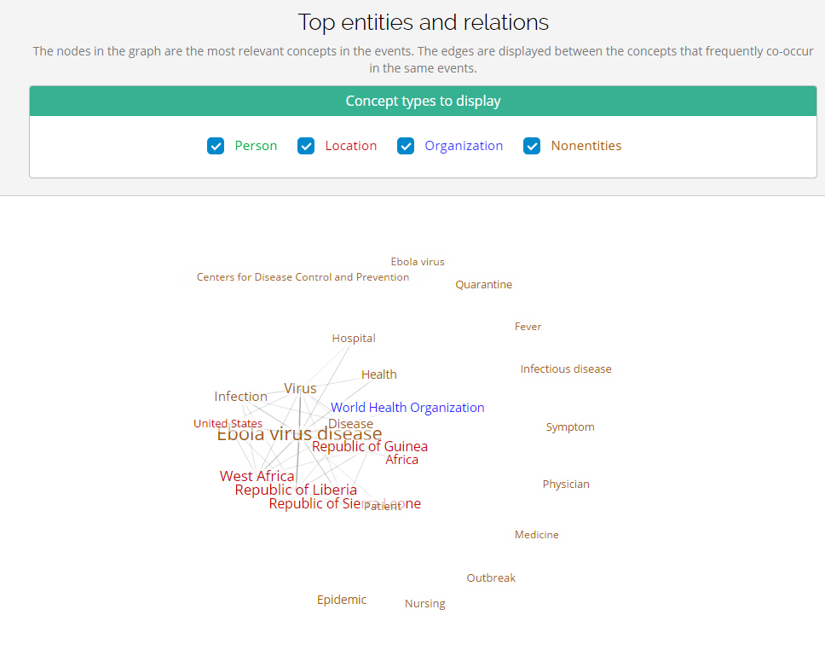

Slide 41
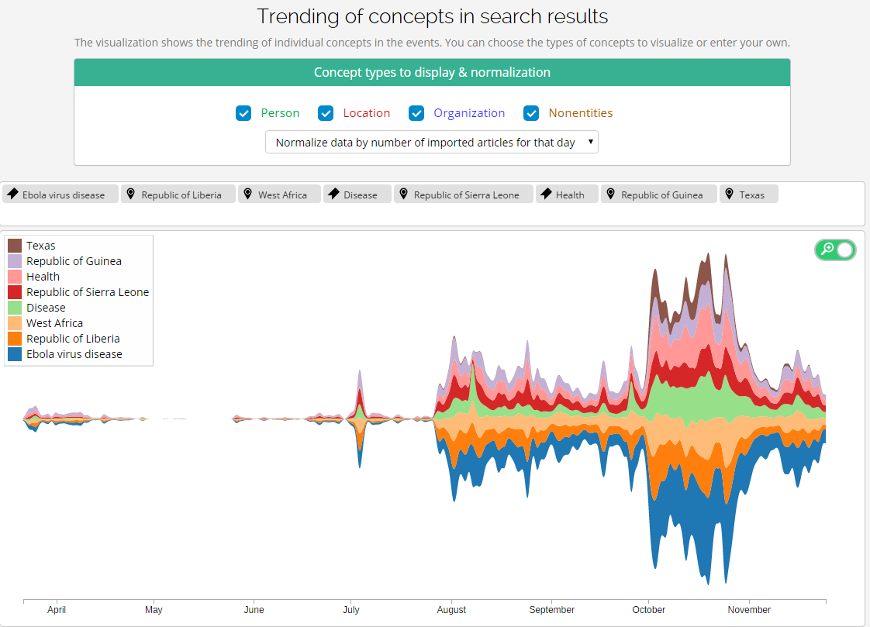

Slide 42
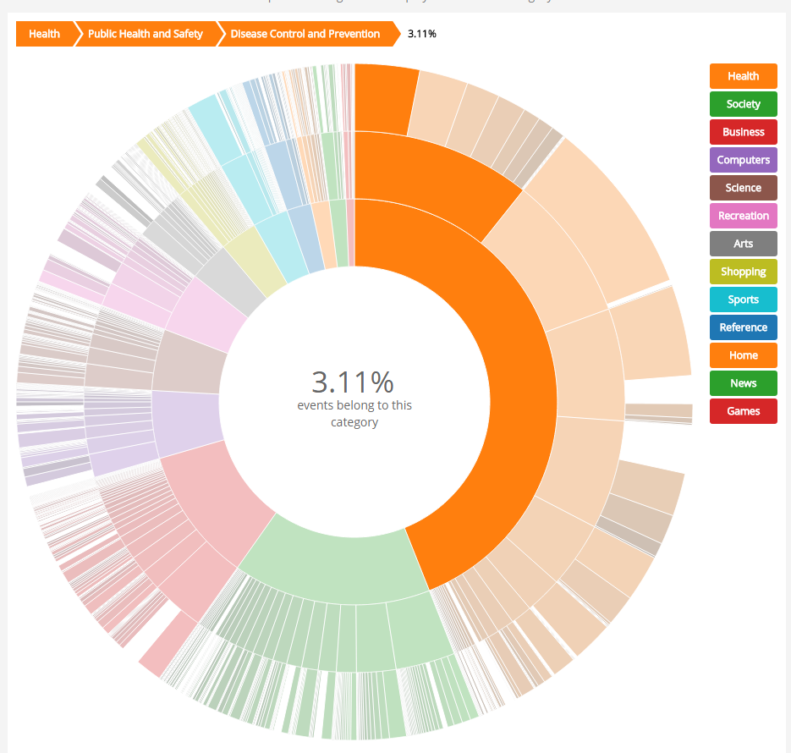

Slide 43
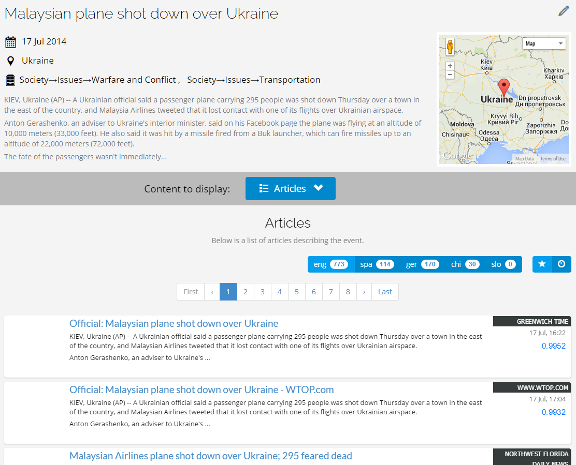

Slide 44
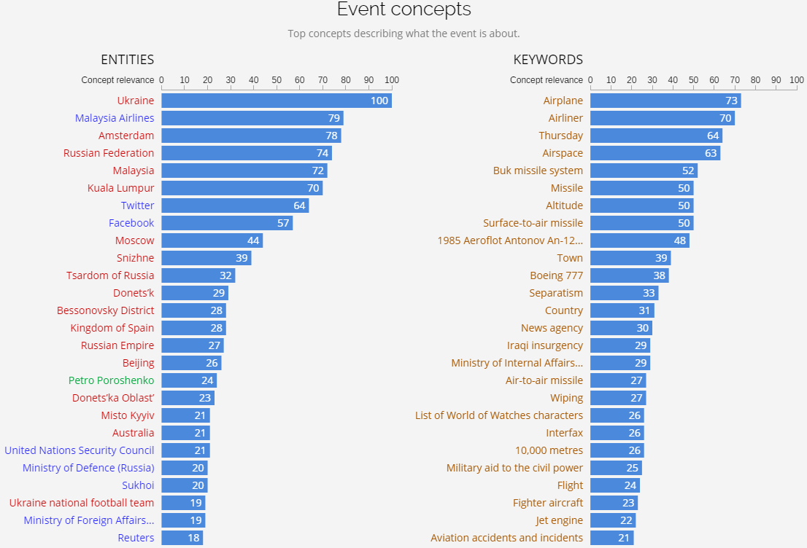

Slide 45
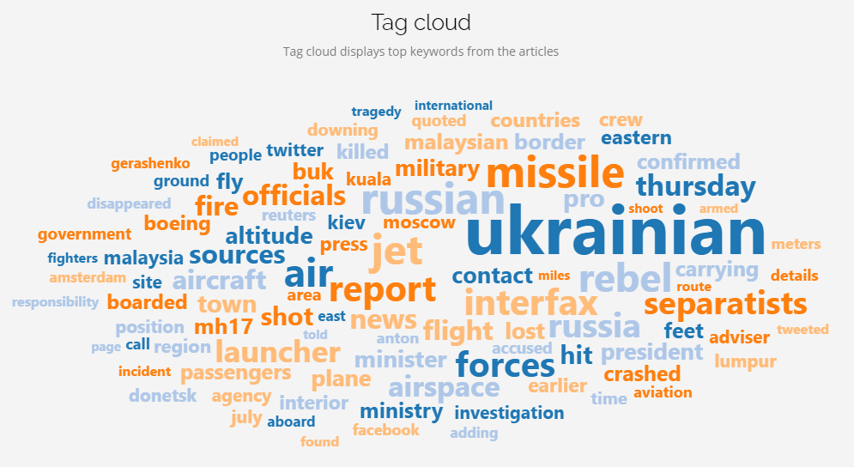

Slide 46
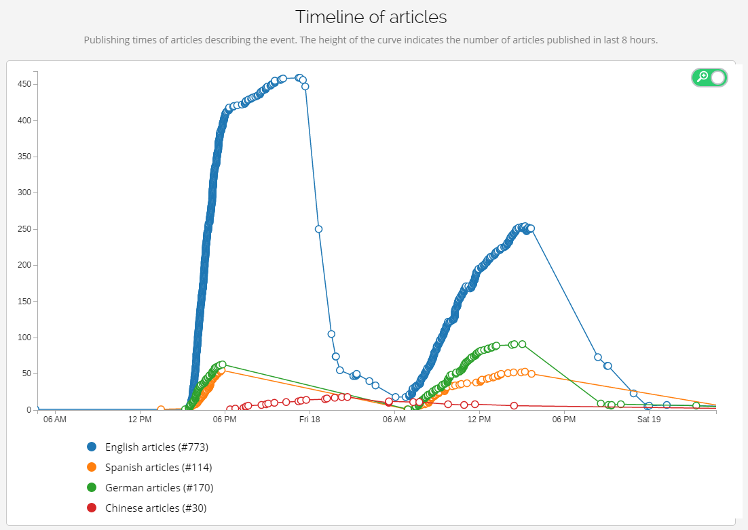

Slide 47
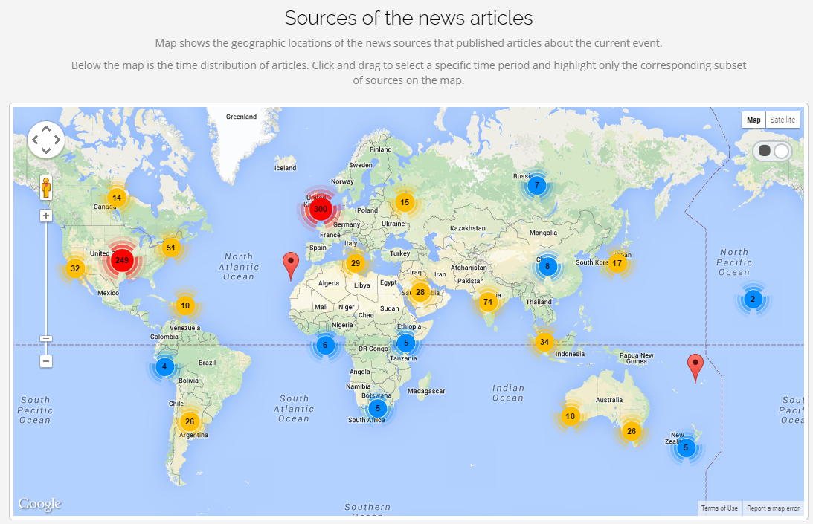

Slide 48
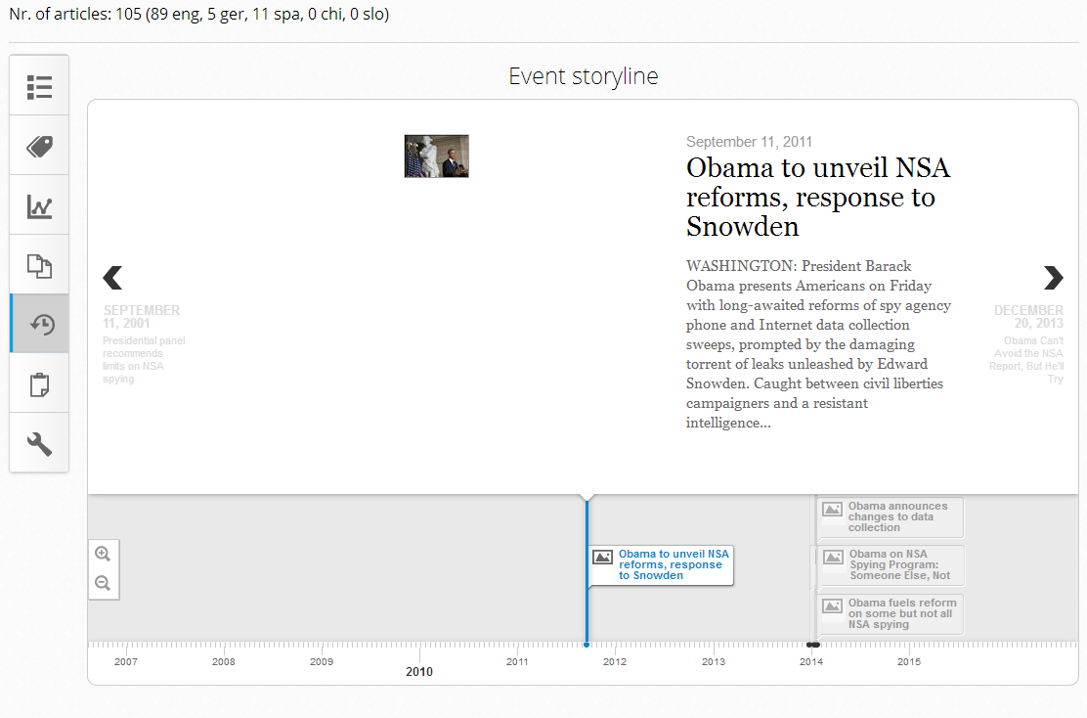

Slide 49
